Slide 1


Slide 2
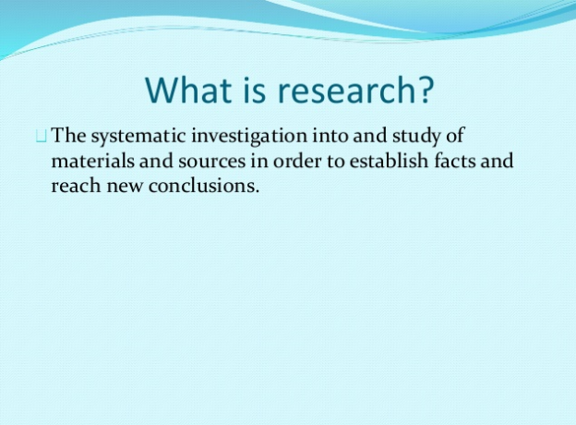

Slide 3
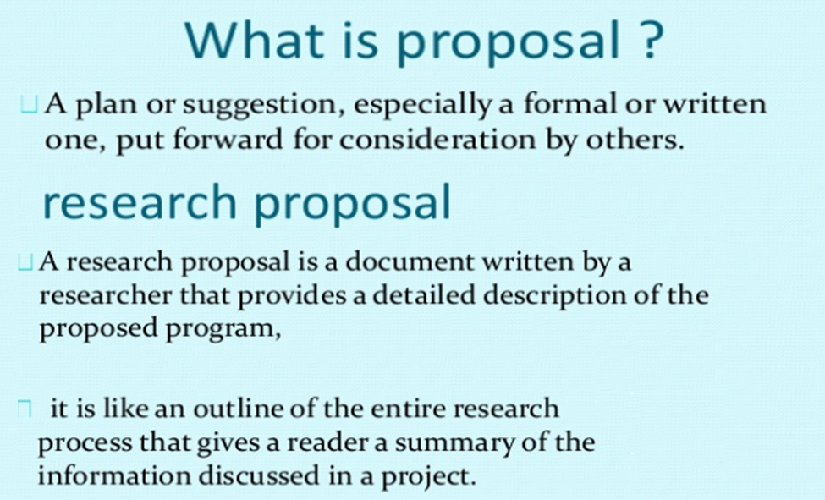

Slide 4
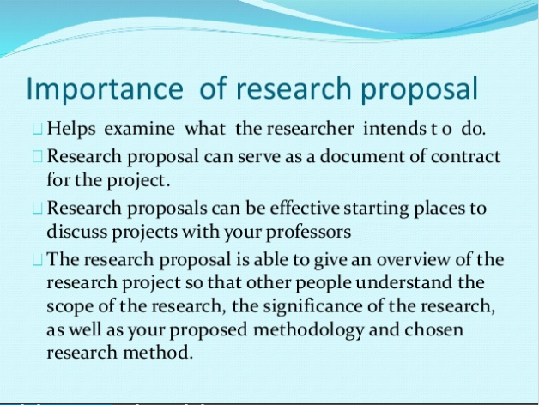

Slide 5
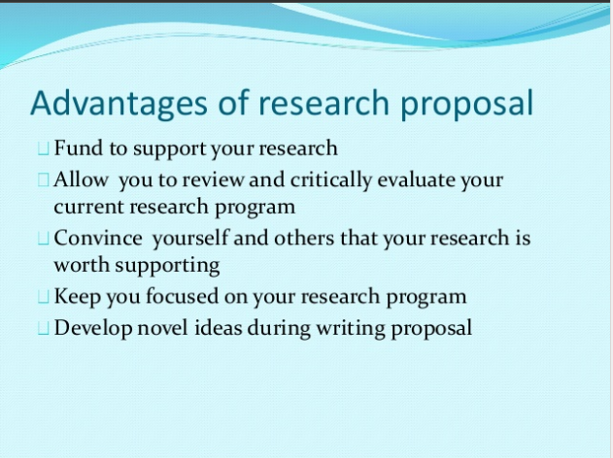

Slide 6
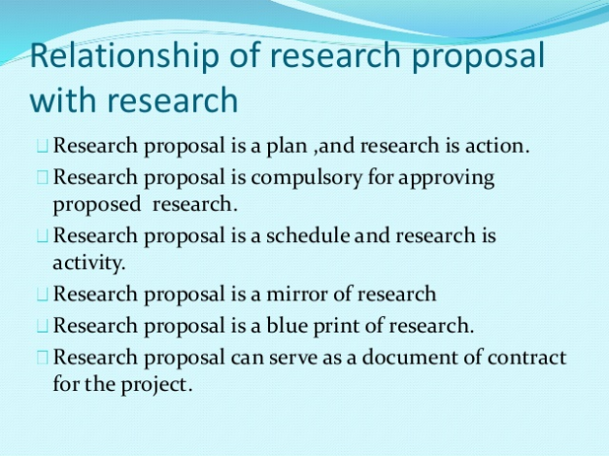

Slide 7
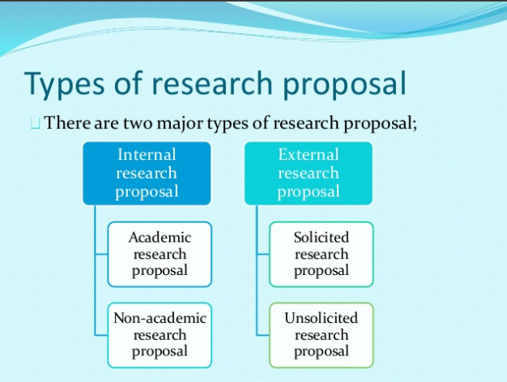

Slide 8
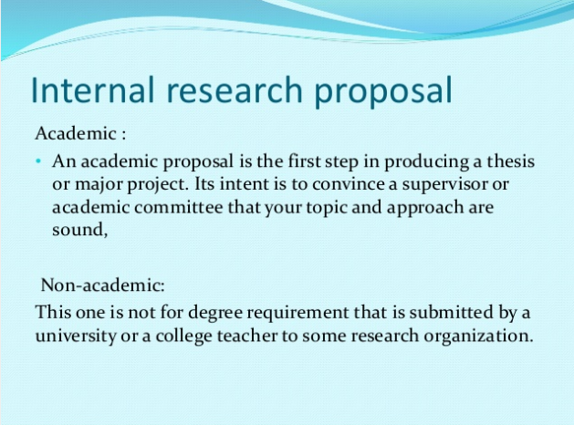

Slide 9
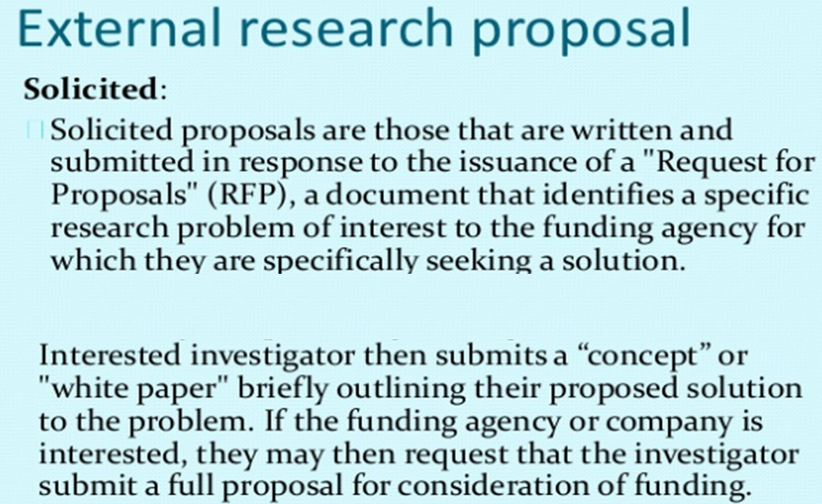

Slide 10
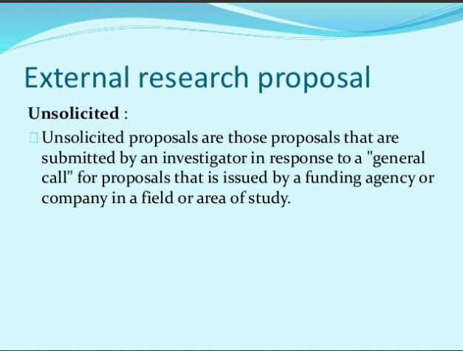

Slide 11
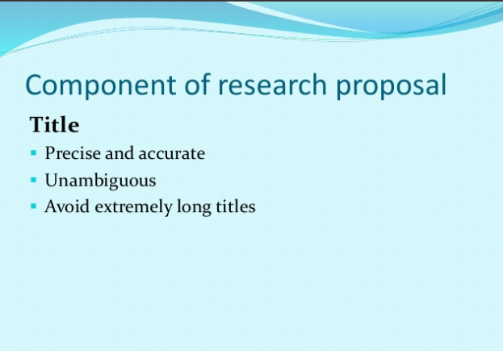

Slide 12
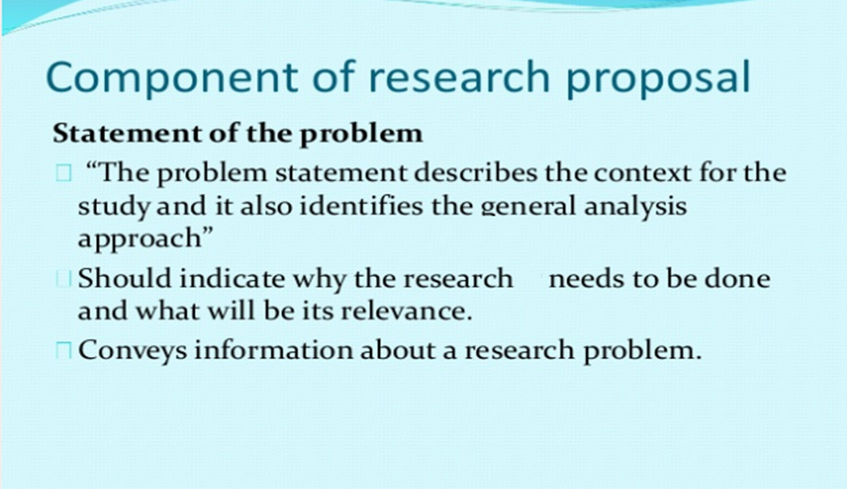

Slide 13
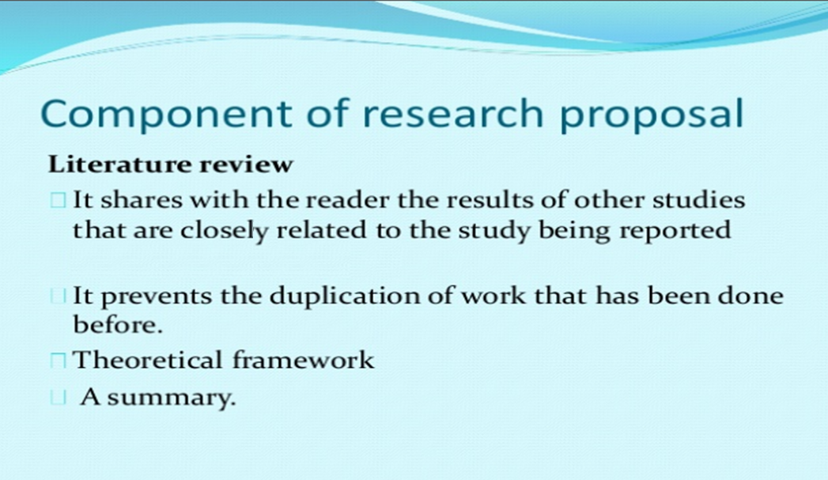

Slide 14
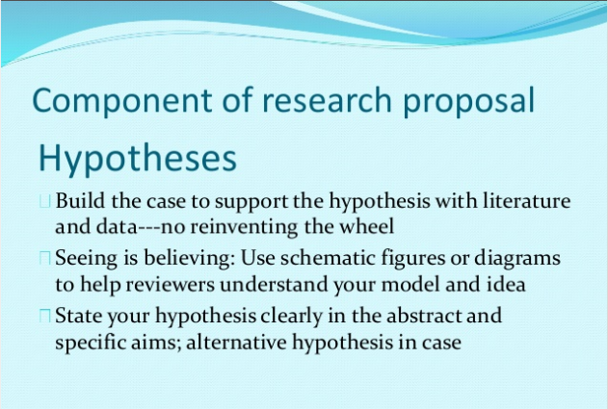
Notes:
Hypotheses; an idea or explanation for something that is based on knownfacts but has not yet been proven:

Slide 15


Slide 16
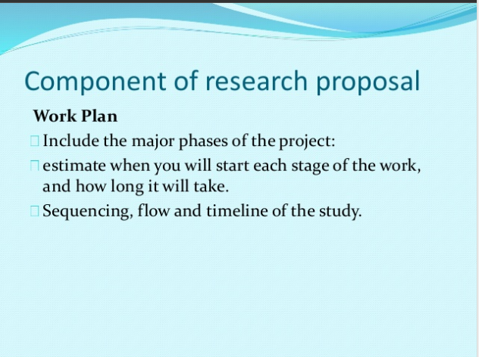

Slide 17
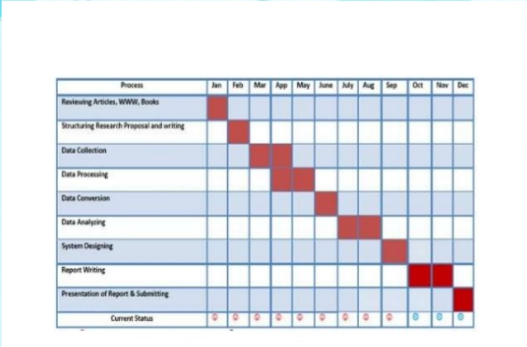

Slide 18
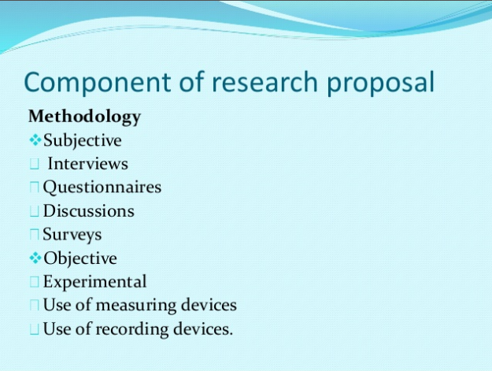

Slide 19
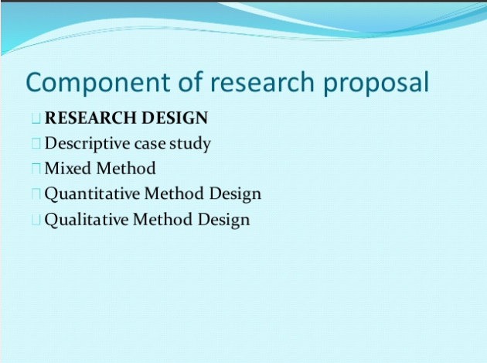

Slide 20
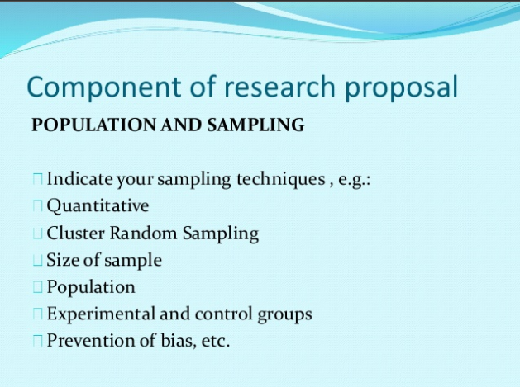

Slide 21
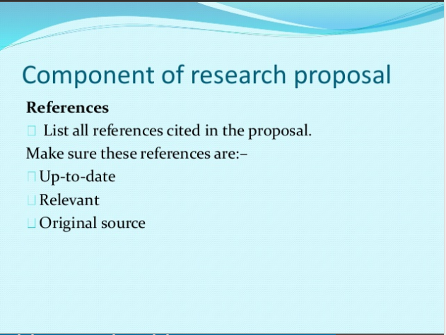

Slide 22
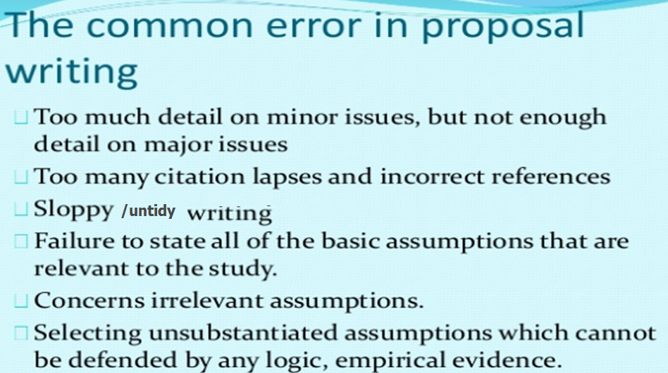

Slide 23
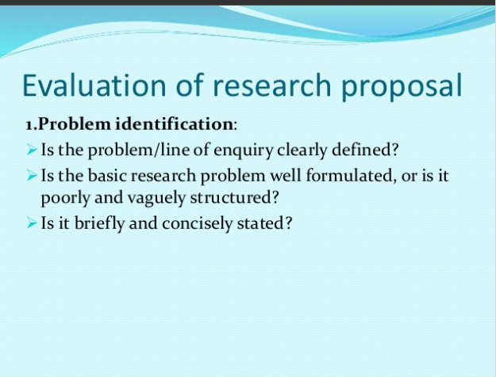

Slide 24
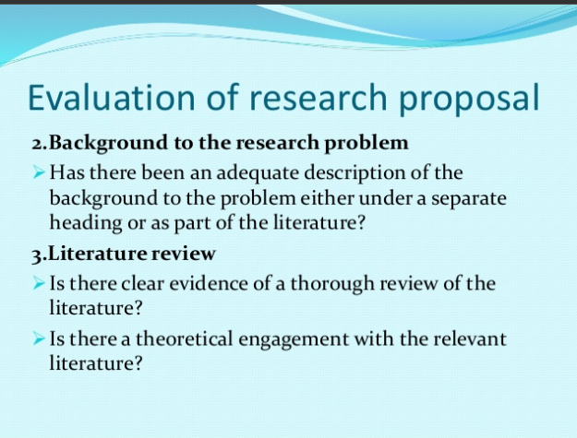

Slide 25
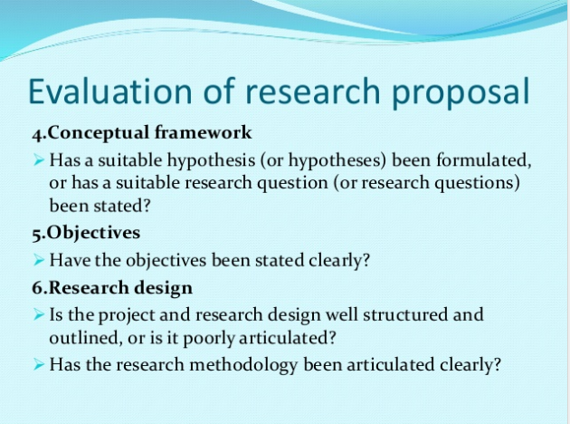

Slide 26
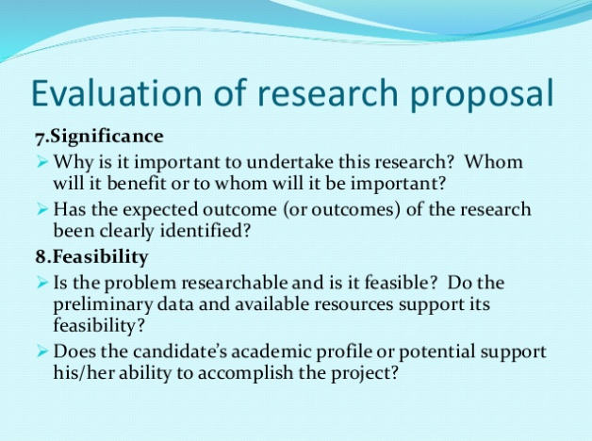

Slide 27
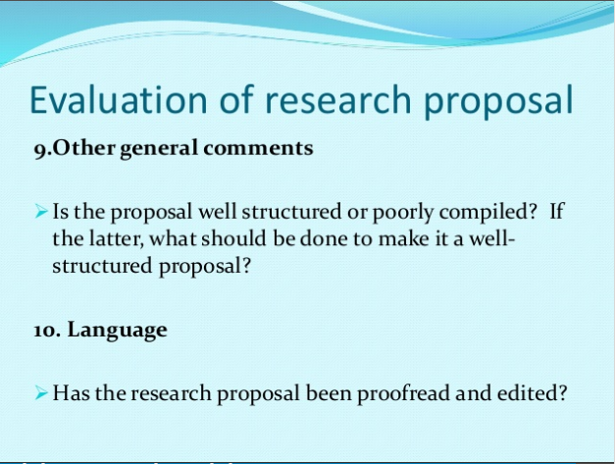

Slide 28


Slide 29
What are ethics?
Refers to the rules of conduct of carrying out research
Ethical issues are present at all stages of research
Essential part of the research process

Slide 30
Research ethics concerns the responsibility of researchers to be honest and respectful to all individuals who are affected by their research studies or their reports of the studies’ results.

Slide 31
Why is Research Ethics Important?
Protects the vulnerable group and other study participants
Participants are safeguarded from exploitation
Establishes risk-benefit ratio for study subjects
Ensures fullest respect, dignity, privacy, disclosure and fair treatment for subject
Builds capability of subjects to accept or reject participation in study

Slide 32
Objectives of Research Ethics
To protect human participants
To ensure that research is conducted in a way that serves interests of individuals, groups and/or society as a whole
To examine specific research activities and projects for their ethical soundness, protection of confidentiality and the process of informed consent

Slide 33
Issues related to Ethical concern in Research
Plagiarism/Copying other people’s work
Misuse of Privileged/private Information
Data
Authorship and Other Publication Issues Buy it
Interference when it Pays well
Subjects of research can be an issue….. Ie when your area of research is very sensitive….thus no one is willing to open up with any sensitive information.

Slide 34
ETHICAL PRINCIPLES
The Belmont report articulates three primary ethical principles
▪ Beneficence/Kindness
▪ Respect for human dignity
▪ Justice

Slide 35
1. BENEFICENCE/KINDNESS
Imposes duty on researchers to minimise harm and to maximise benefits
The right to protect from harm and discomfort
Freedom from exploitation
Benefits from research
2.THE PRINCIPLE OF RESPECT FOR HUMAN DIGNITY
The right to self determination-Humans should be treated as independent agents, capable of controlling their own activities
The right to full disclosure-Researcher should fully describe the nature of study, subject’s right to refuse participation, researcher’s responsibility and risks and benefits

Slide 36
3.THE PRINCIPLE OF JUSTICE
• The right to fair treatment
• The right to privacy

Slide 37
ETHICS CODES AND POLICIES FOR RESEARCH
HONESTY - maintain honesty in all communications, e.g., when reporting data, results, and procedures. Never fabricate, falsify, or misrepresent data
OBJECTIVITY - Avoid biases in the experimental design, data analysis, interpretation, expert testimony, and other aspects of research
INTEGRITY - Keep promises and agreements. Act with sincerity and strive for consistency of thought and action
CARE - Avoid careless errors and negligence. Critically examine your work and the work of your peers. (good order and condition)
OPENNESS - Share data, results, ideas, and resources. Be open to criticisms and new ideas
RESPECT FOR INTELLECTUAL PROPERTY - Honor patents and copyrights. DO NOT use unpublished data, methods, or results without permission. Give proper credit .

Slide 38
CONFIDENTIALITY - Protect confidential communications or documents
RESPONSIBLE PUBLICATION - Publish in order to advance research and scholarship. Avoid wasteful and duplicative publication.
RESPONSIBLE MENTORING - Help, educate, mentor, and advise students.
RESPECT FOR COLLEAGUES - Treat peer fairly
RESPONSIBLE MENTORING - Help, educate, mentor, and advise students.
RESPECT FOR COLLEAGUES
SOCIAL RESPONSIBILITY - Strive to promote social good and prevent social harm
NON-DISCRIMINATION - All those eligible to participate in research must be allowed to do so
COMPETENCE - Maintain and improve your own professional expertise .
LEGALITY - Know and obey relevant laws and institutional and government policies
HUMAN SUBJECTS’ PROTECTION -Minimize harms and risks to human lives; instead, maximize benefits, and respect human dignity, privacy, and autonomy

